Slide 1

FEASIBILITY ANALYSIS AND PERFORMANCE TESTING OF COLLISION DETECTION ALGORITHMS FOR SATELLITES
Capstone Project Phase B
23-2-D-17
Hallel Weil
Omer Shamir
Supervisor: Mr. Ilya Zeldner

Slide 2
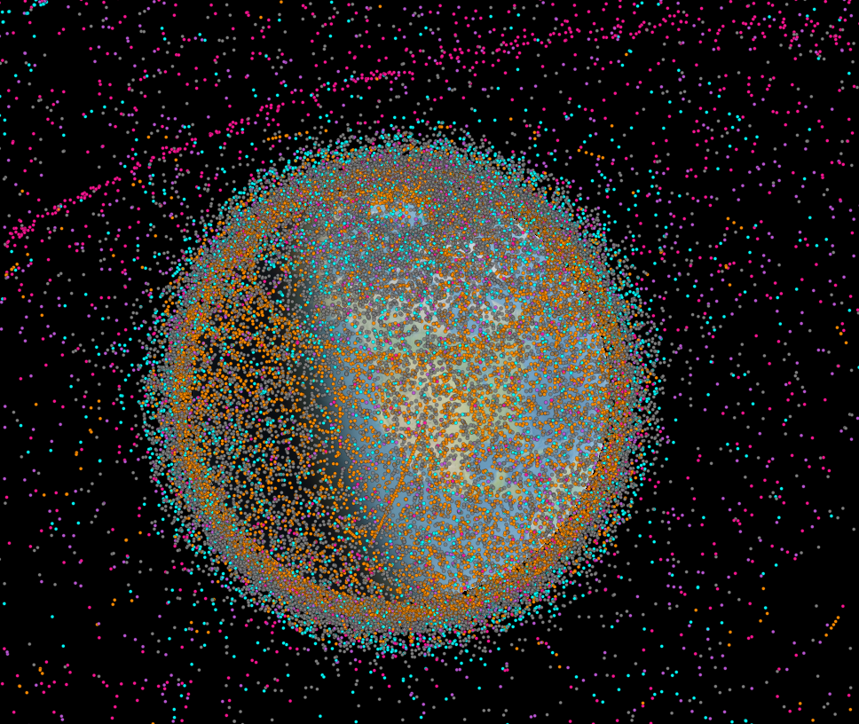
Introduction
Active\Old Satellites, Space debris
Satellites
Space debris
Finding possible collisions
Implementing on a satellite on-board computer
Active satellites[orange]
Inactive satellites[Blue]
Space debris[Grey]
Rocket bodies[purple]
Uncategorized[pink]
Notes:
הצגה קצרה של הרקע: הבעיה, הצורך לפיתוח המערכת
הבעיה

Slide 3
Introduction
Finding the minimal distance
Small time step
Approximations using polynomials
Notes:
הצגה קצרה של הרקע: הבעיה, הצורך לפיתוח המערכת
הצורך בפיתוח

Slide 4
Algorithms
ANCAS
SBO ANCAS
CATCH
Notes:
הצגה קצרה של הרקע: הבעיה, הצורך לפיתוח המערכת
הבעיה – האלגוריתמים

Slide 5
Expected result
Implemented, tested and ready to use algorithms
Testing system
Experiments result, feasibility of using the algorithms on satellites
Notes:
הדרישות המרכזיות של הפתרון

Slide 6
Solution
Implementing the algorithms
2 Parts testing system
Comparing algorithms performance
Notes:
תיאור הפתרון

Slide 7

Algorithms Implementation
Implemented in C++
Eigen for finding eigenvalues
Unit test and CelesTrak + SOCRATES
Notes:
תיאור הפתרון
מומש בCpp
Using eigen
Testing with unit tests for finding the roots and such
Comparing rasults using celectrak website and sicrates project(showing possible collosions and TLE available)

Slide 8

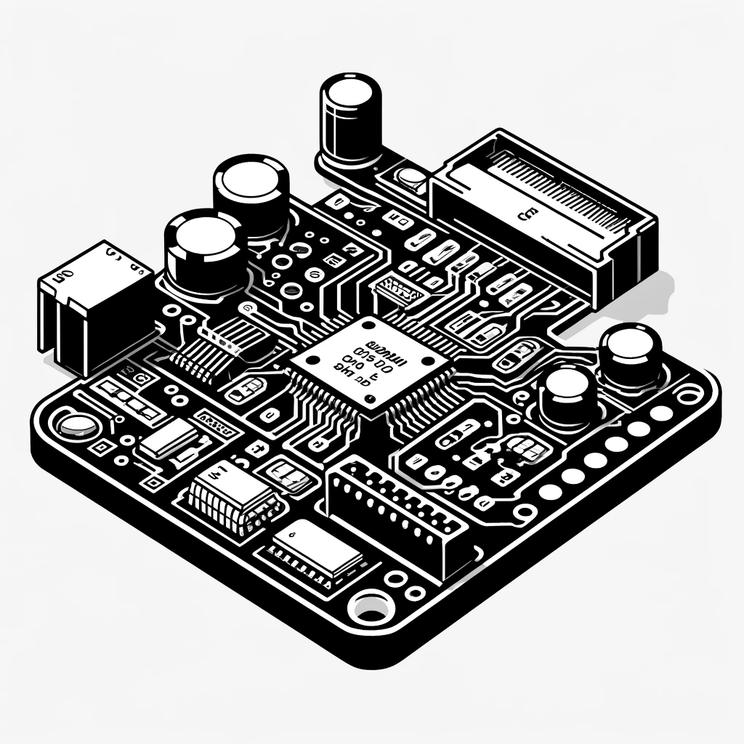
Testing System
2 parts testing system
Testing station
Tested on-board computer
User Interface
Test Creation and Management
Results Management
Database
Running tests
Running the algorithms
Testing runtime
Notes:
תיאור הפתרון

Slide 9
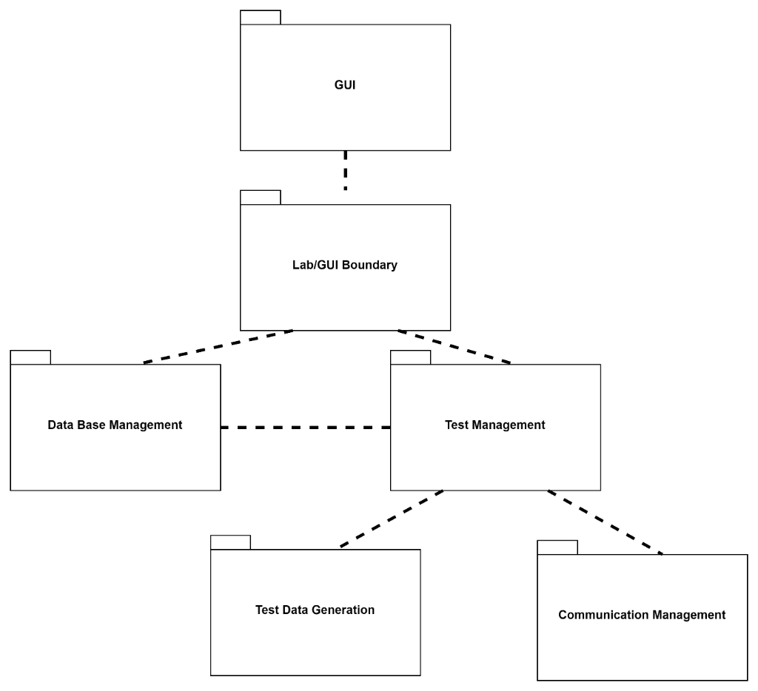
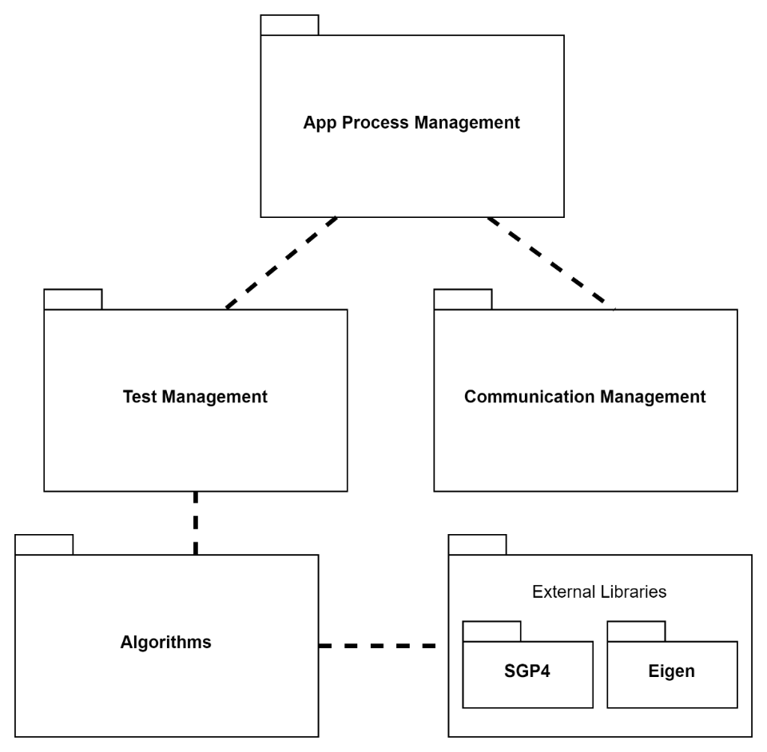
Testing System
Testing station
Tested on-board computer
Notes:
Package diagrams

Slide 10
Testing System - Communication
Defining a communication protocol
Error detection - CRC
Work on:
UDP
TCP
Local simulation
Notes:
Package diagrams

Slide 11
Testing System – Environments - Windows
Windows / WSL
TCP/UDP over Local host
Local simulation
Notes:
Package diagrams

Slide 12
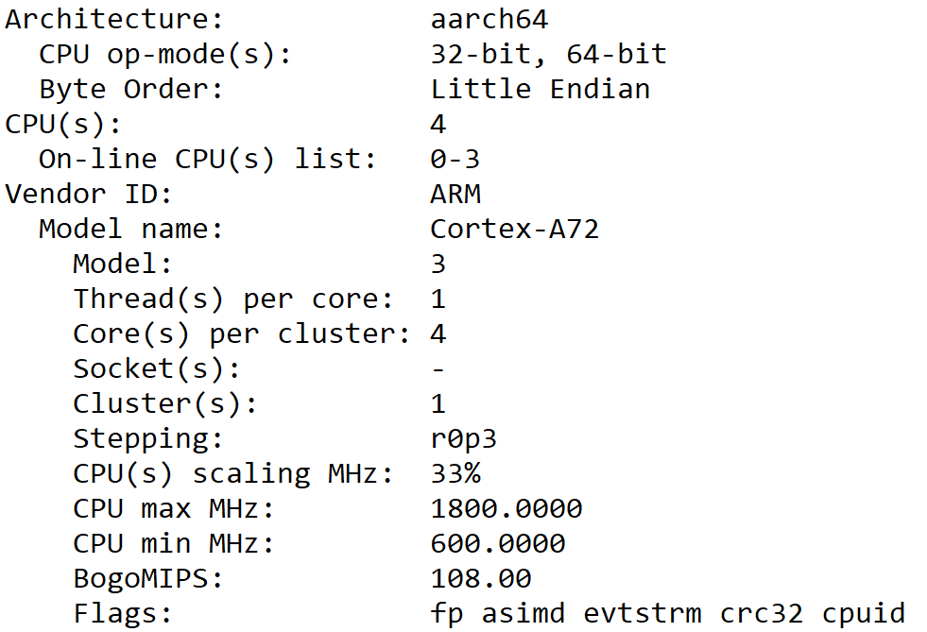
Testing System - Environments – RP4
Linux on Raspberry Pi 4
TCP/UDP
Testing Cross – Platform Communication
Notes:
Package diagrams

Slide 13
Testing System – Environments - Simulation
gem5 simulation
Open source, Community led project
Framework for computer systems simulations
Accurate timing
Notes:
Package diagrams

Slide 14
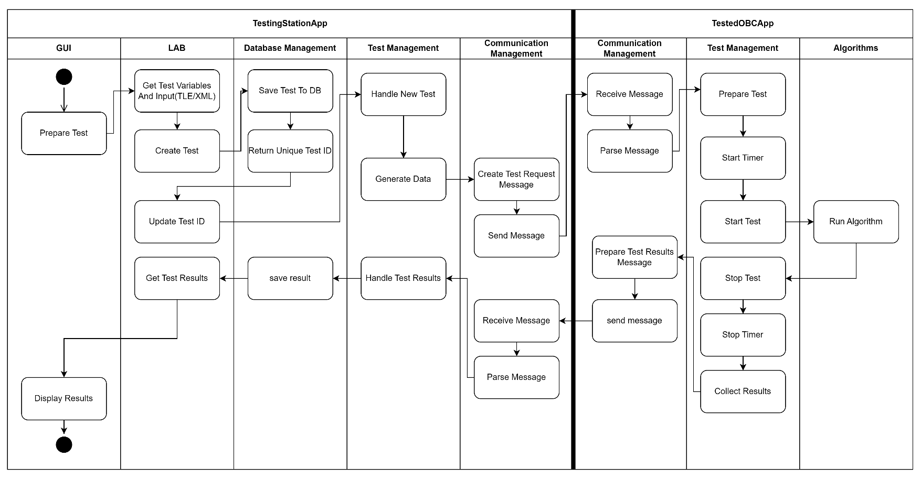
Testing System – Activity Diagram
Notes:
Activity diagrams

Slide 15
Feasibility Testing Environments
gem5 simulator with WSL
Simulation script - se
 | OBC[ ] | gem5 simulation script
CPU | 32-bit ARM9 | SimpleTimingCPU
CPU Frequency | 400MHz | 400MHz
Cache | 32-KB Data, 32-KB Instruction | 32-KB Data, 32-KB Instruction
Memory | 32MB SDRAM | SimpleMemory
Notes:
תיאור הפתרון

Slide 16
Feasibility testing - data
Catalog of objects from Celestrak - 9727 active satellites
Used around 20% - ~5700 tests
3 days to run the simulation
Notes:
תיאור הפתרון

Slide 17
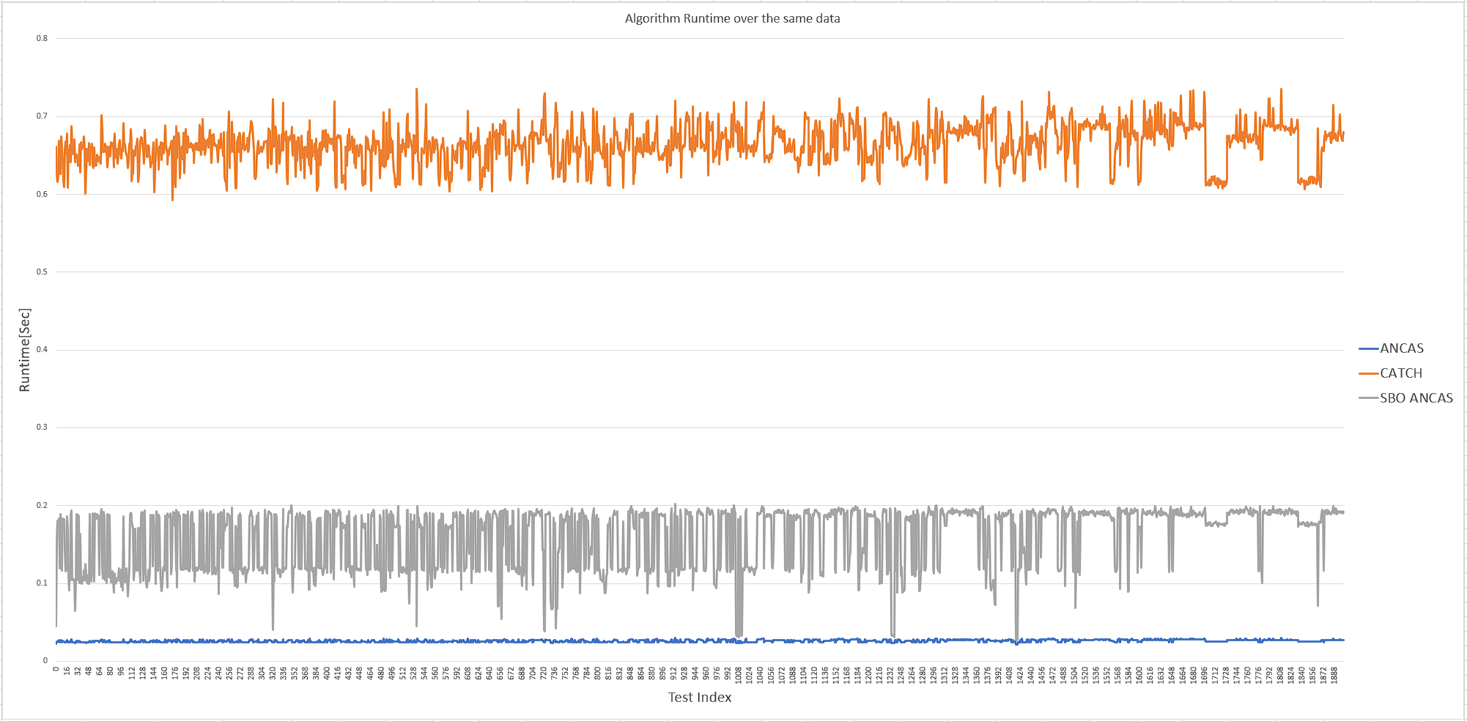
Feasibility testing - runtime
Notes:
תיאור הפתרון

Slide 18
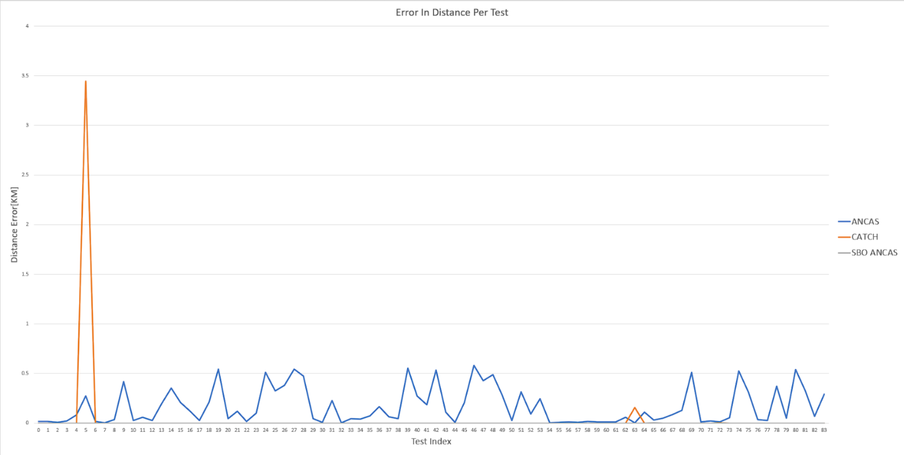
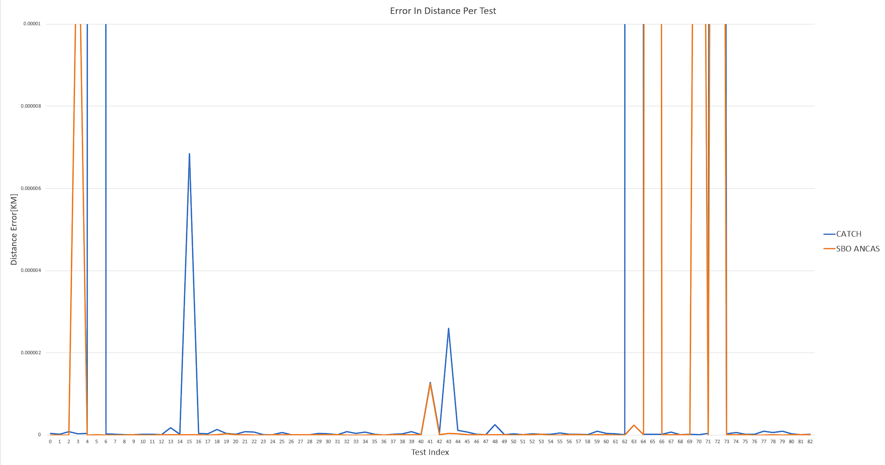
Feasibility testing - errors
Algorithm | Average Runtime[Sec] | Average Distance Error[KM] | Average #Points | Test With Distance Error > 0.00001[KM] | Test With Distance Error > 0.100[KM]
ANCAS | 0.026057568 | 0.222462893 | 3019 | 1902 | 783
SBO ANCAS | 0.159591541 | 0.007744792 | 3019 | 91 | 8
CATCH | 0.663982872 | 0.022729184 | 3019 | 41 | 12
Notes:
תיאור הפתרון
להוסיף?

Slide 19
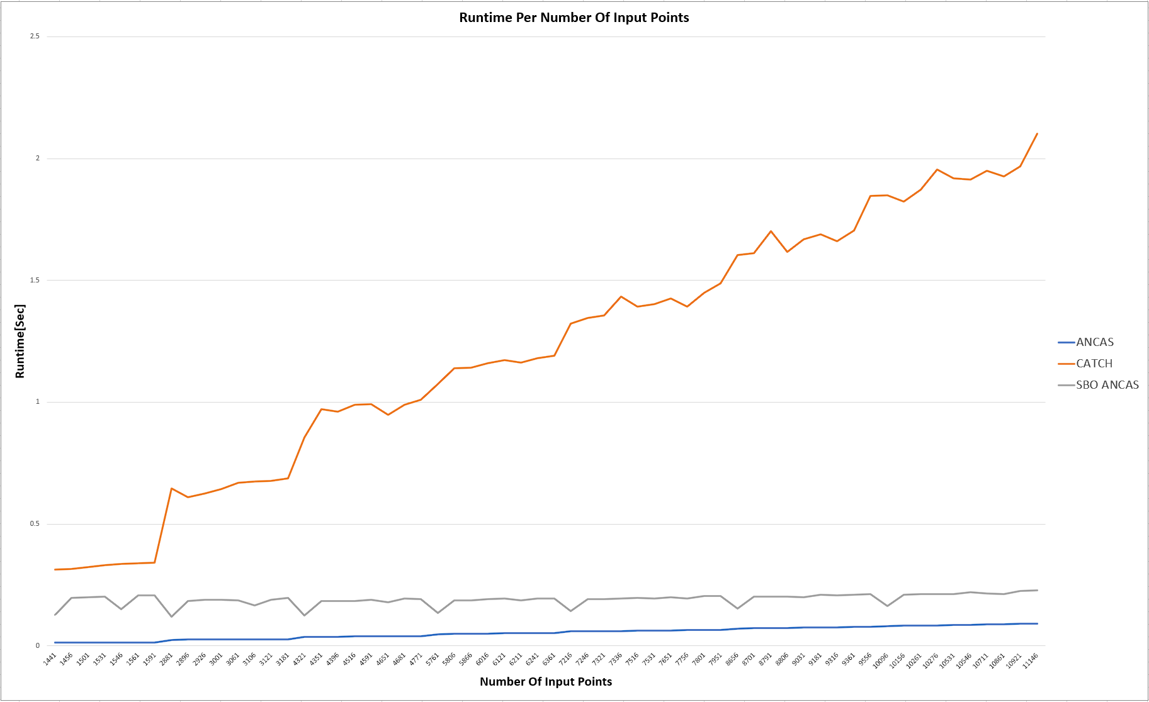
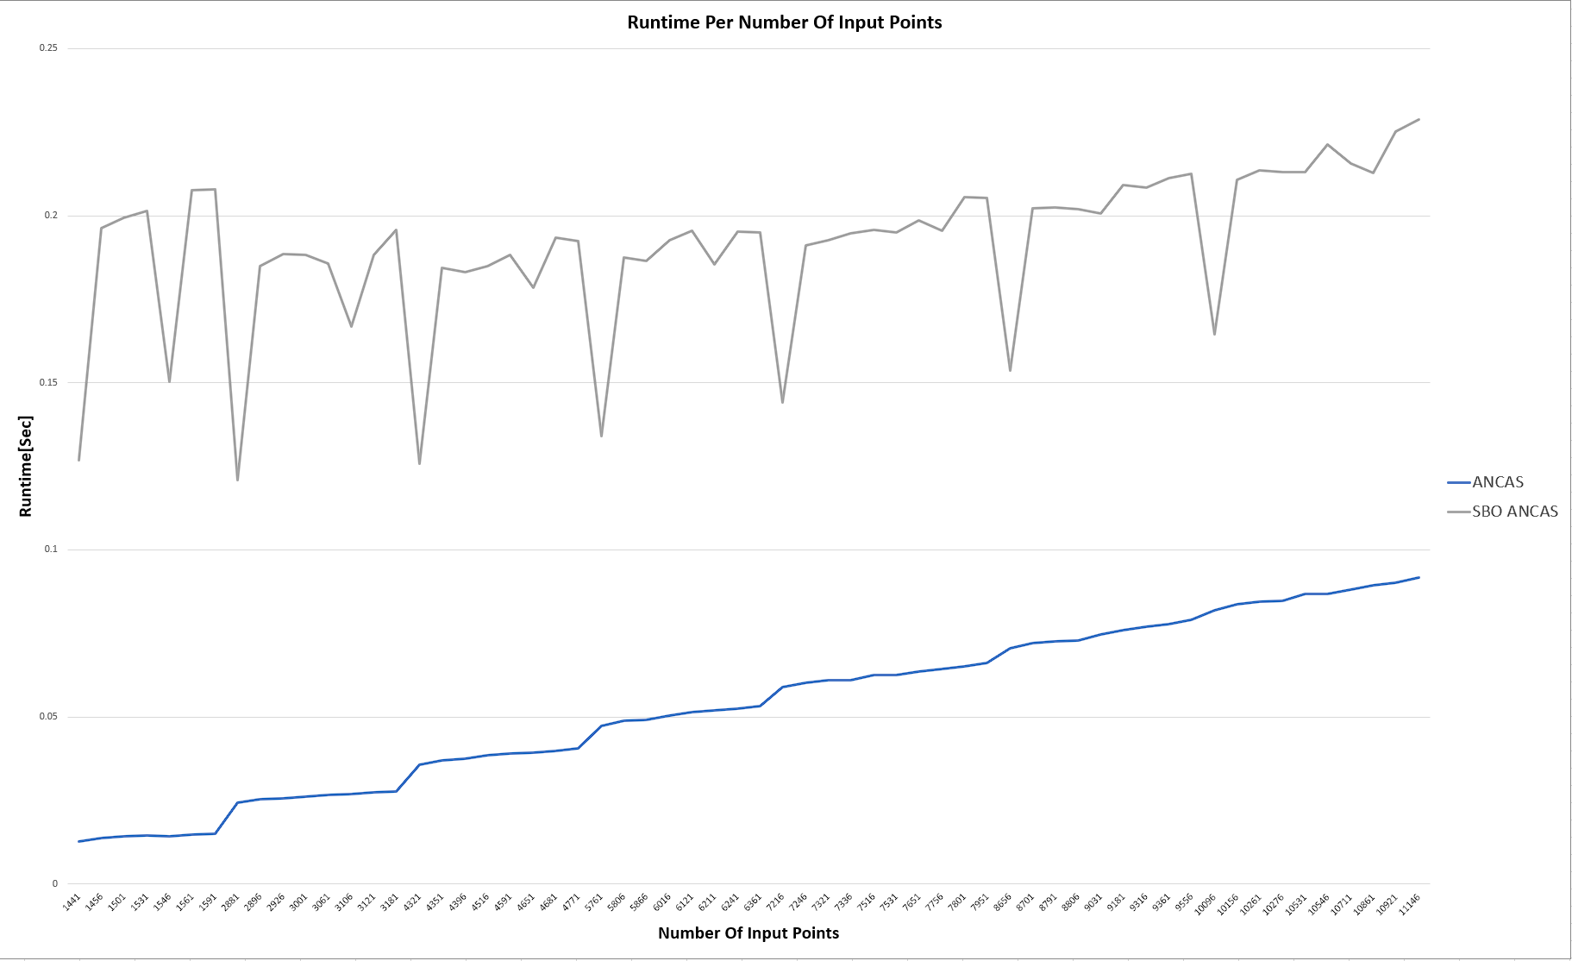
Feasibility testing – correlations
Constant time interval- changing number of points
Notes:
תיאור הפתרון

Slide 20
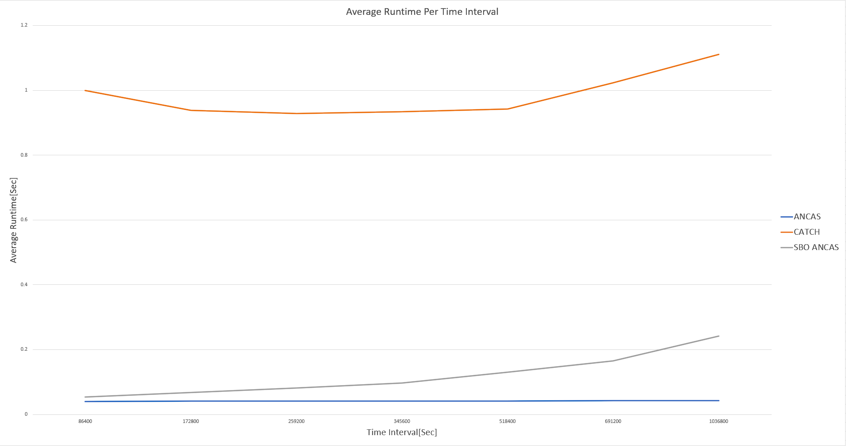
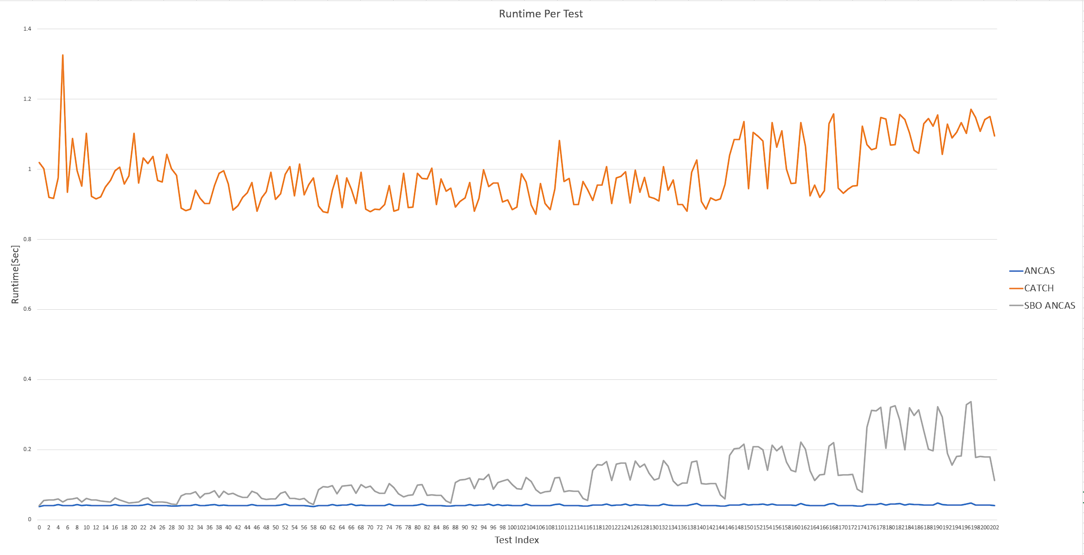
Feasibility testing – correlations
Constant number of points – changing time interval
Notes:
תיאור הפתרון

Slide 21
Challenges
Developing for unknown / multiple systems
Types
Padding
Different functions
Testing and debugging
Unit tests
Local Simulations
Notes:
תיאור אתגרים ובעיות

Slide 22
System Testing
Unit tests
Local Simulation with test cases
RP4 cross platform communication testing
Acceptance testing
Notes:
תיאור אתגרים ובעיות

Slide 23
User Interface – Video

Slide 24
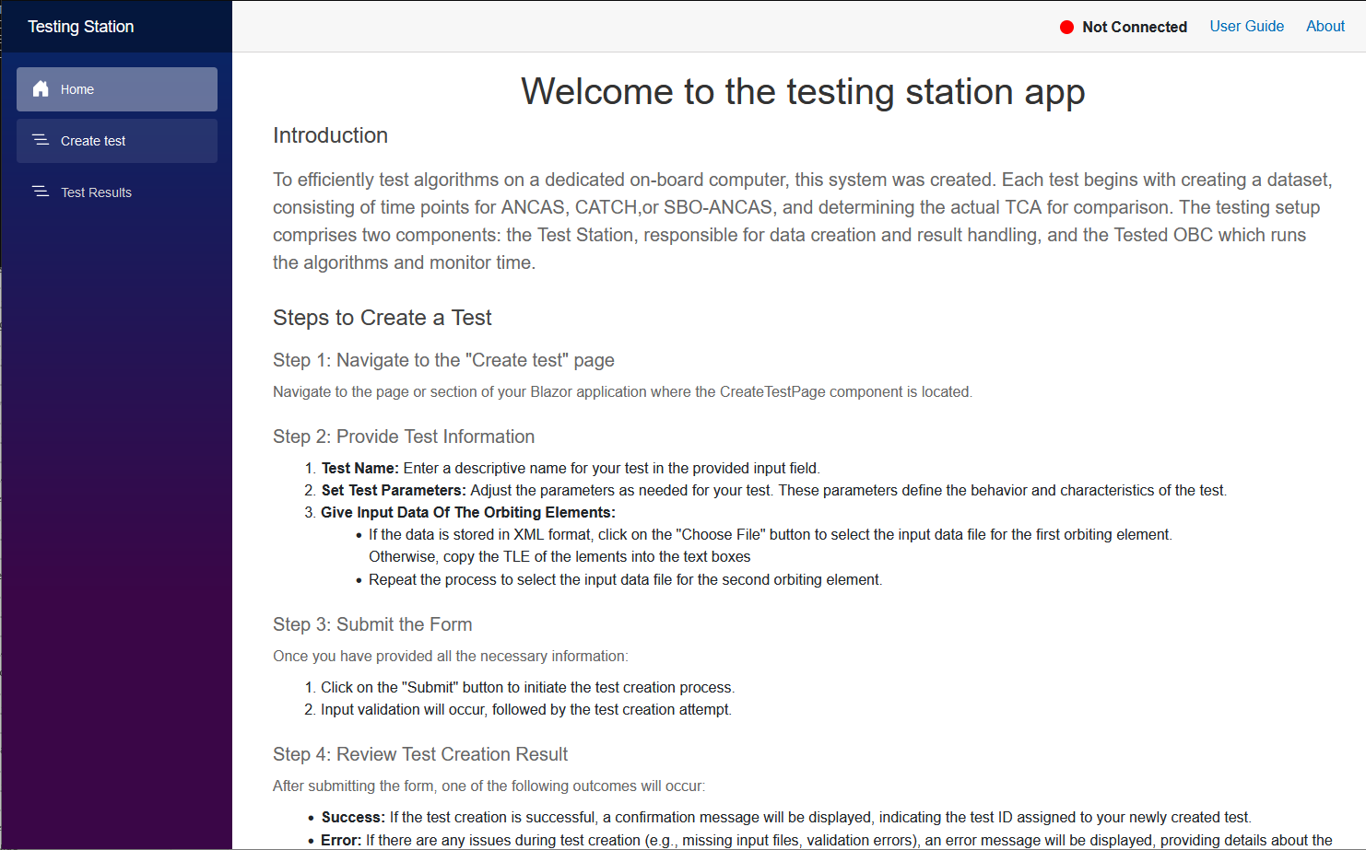



User Interface – Home Page

Slide 25
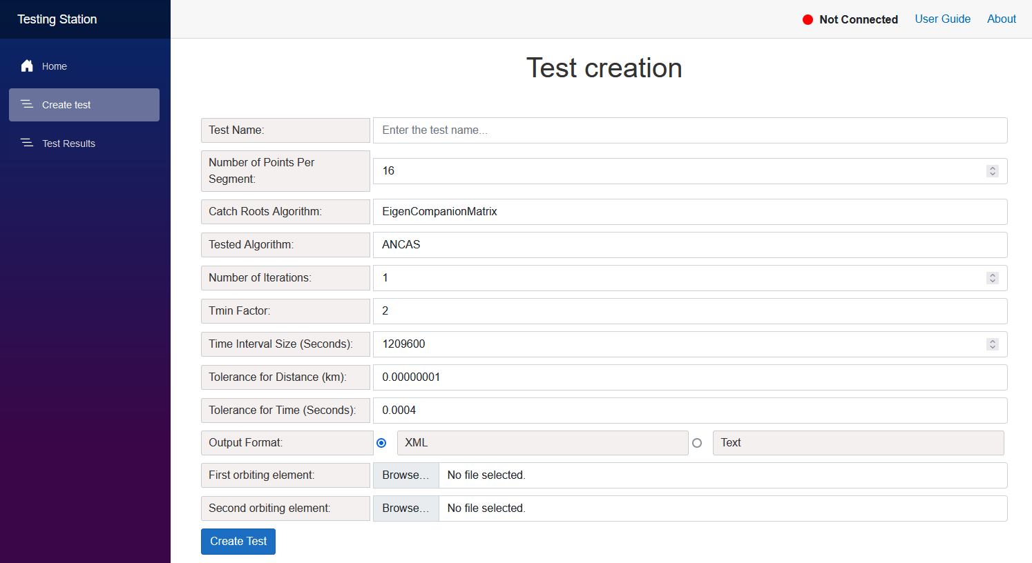
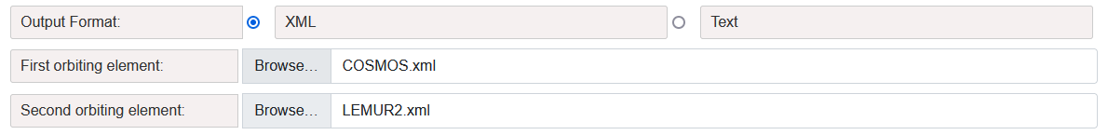
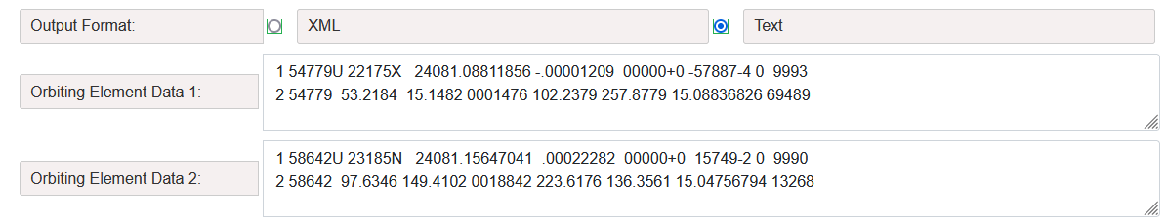
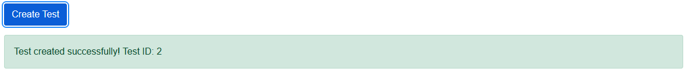
User Interface – Create Test

Slide 26
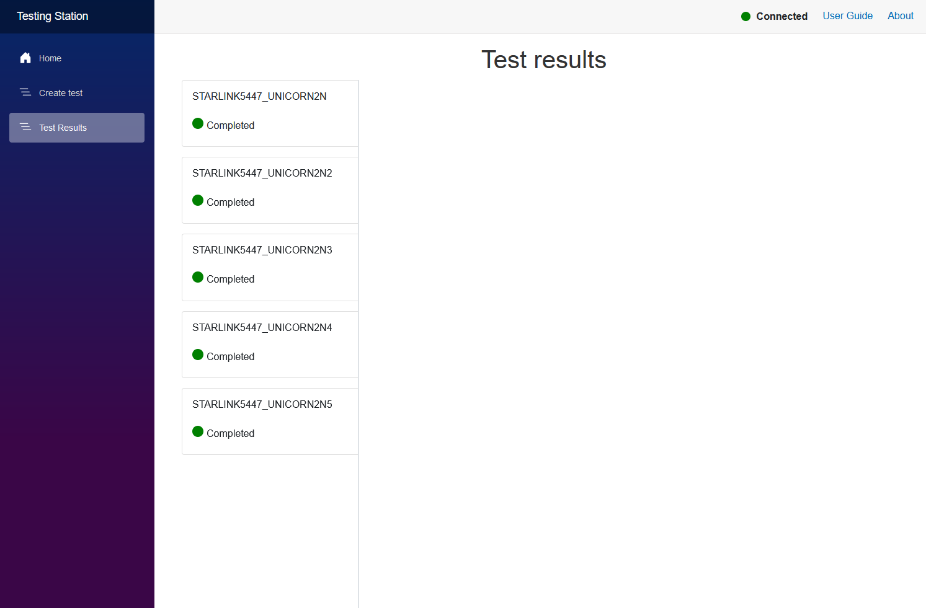
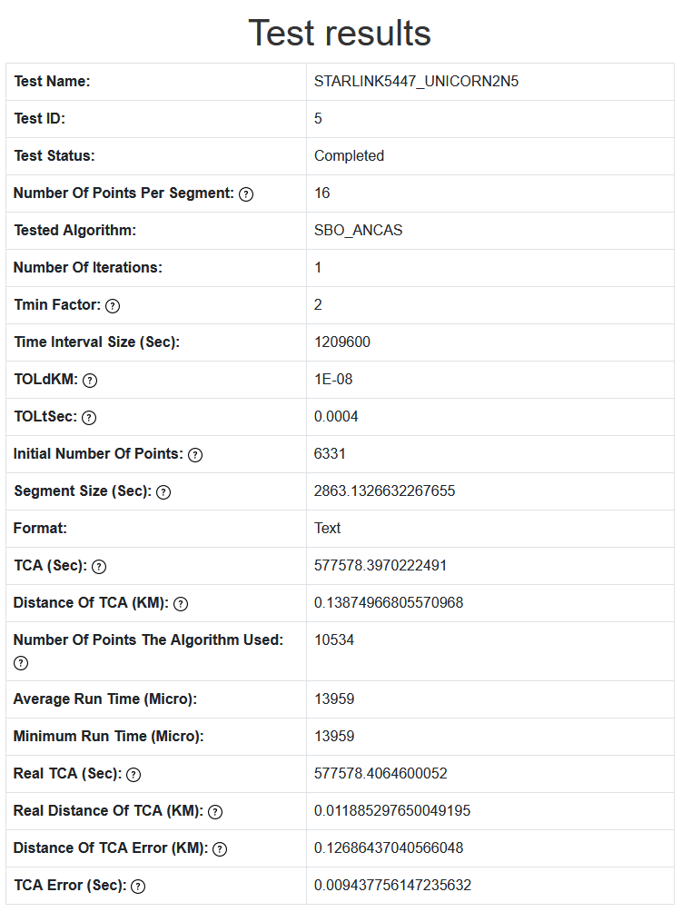
User Interface – Test Results

Slide 27
Bibliography
[1] Denenberg, Elad. "Satellite closest approach calculation through Chebyshev Proxy Polynomials." CATCH
[2] Alfano, S. "Determining Satellite Close Approaches-Part II." ANCAS
[3] Denenberg, Elad. Gurfil, Pini. “Improvements to Time of Closest Approach Calculation.” SBO ANCAS
[4] NASA on orbital debris: NASA
[5] CelesTrak: https://celestrak.org/
[6] CelesTrak Current Data: https://celestrak.org/NORAD/elements/index.php?FORMAT=tle
[7] The gem5 simulator: https://www.gem5.org/
[8] ISISPACE OBC: https://www.isispace.nl/product/on-board-computer/
[10] Our GitHub repository: https://github.com/ommersh/Final-Project

